Slide 1
SBA Loans
By: Morgan, Deautaun, Eduardo

Slide 2
What is an SBA Loan?
U.S. Small Business Administration (SBA) Loan
A loan that business owners get as means to start their business before the opportunity making a profit.
When you fail to repay a loan in time, you have defaulted.
Notes:
Unlike conventional term loans, SBA loans offer business owners the opportunity to take advantage of lower down payments and favorable terms while removing some of the barriers of traditional financing options.

Slide 3
Questions:
What factors affect how much the loan is for?
What factors tend to cause a loan to be defaulted on?
Build a model to predict which approved loan applications will default on their loan.

Slide 4
What factors affect how much the loan is for?
Industry
Existing Business
Franchise

Slide 5
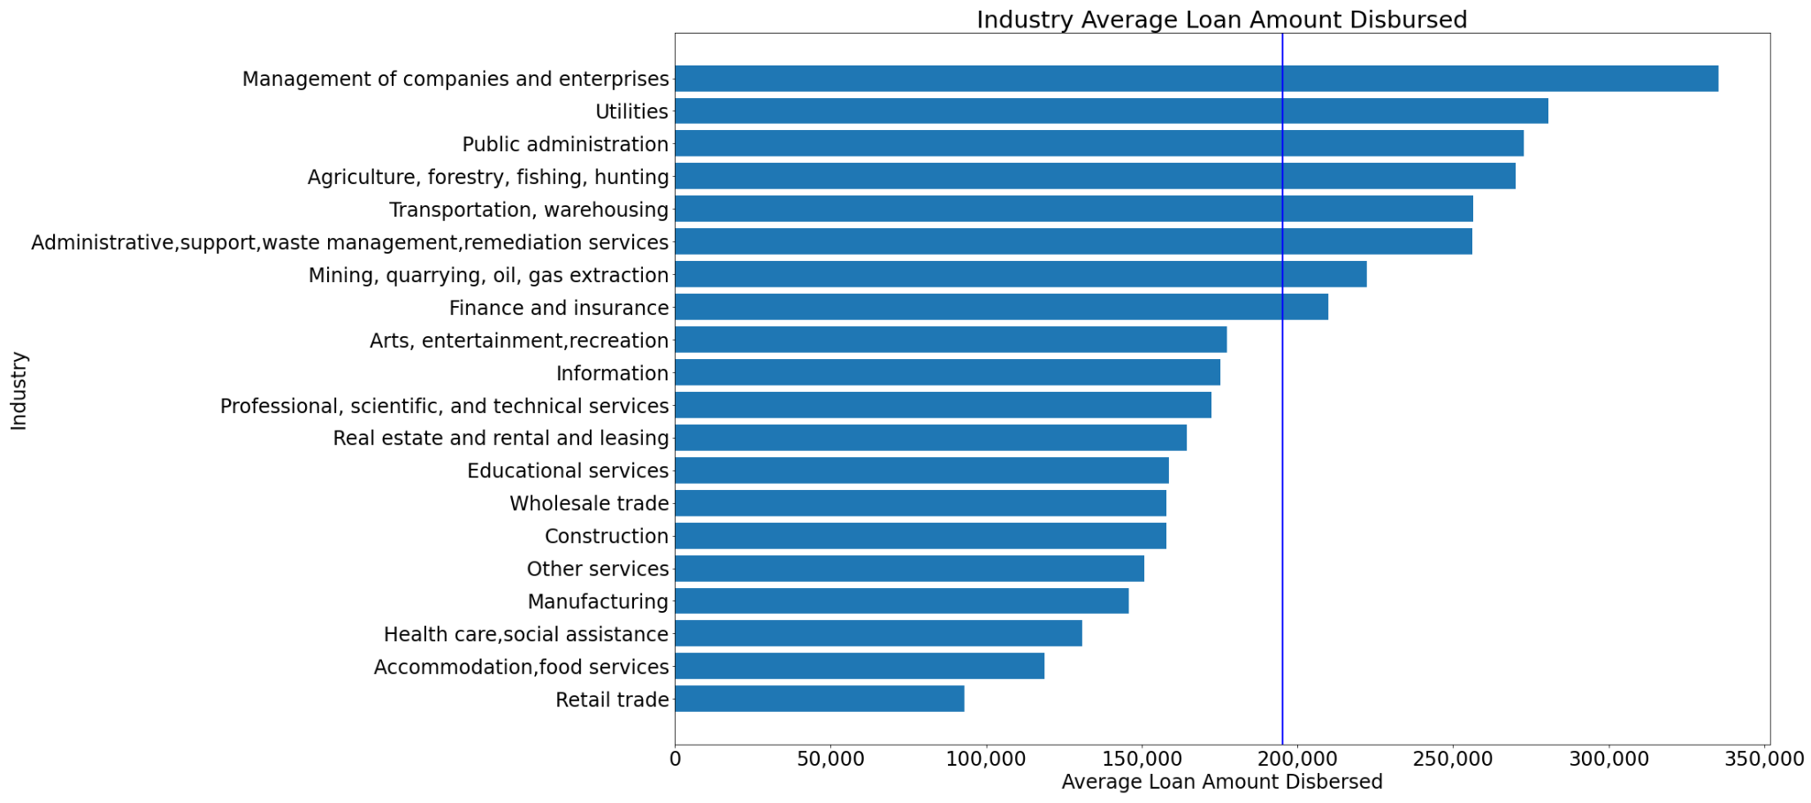
Industries and their Average Loan Disbursed
Notes:
Attempt to add average line

Slide 6
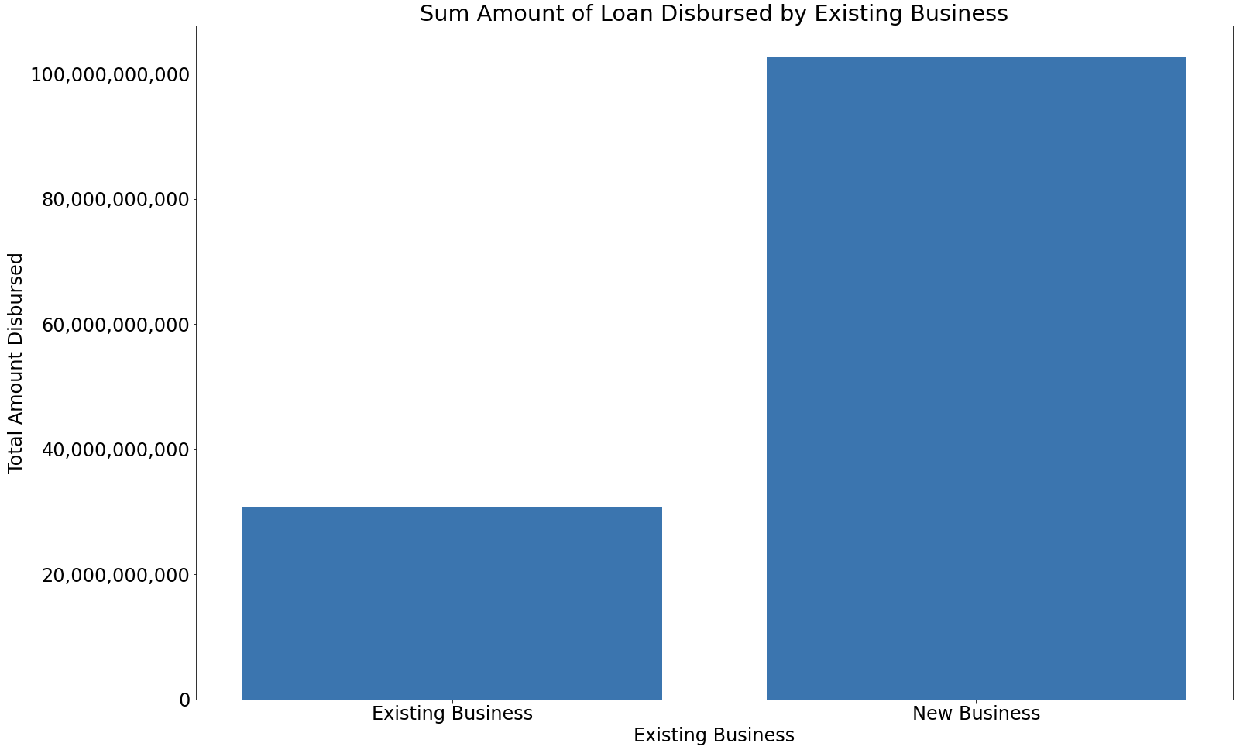
Sum of Loan Disbursed by Existing Business
New Business is only 30% of our data yet have higher Loan disbursement.

Slide 7
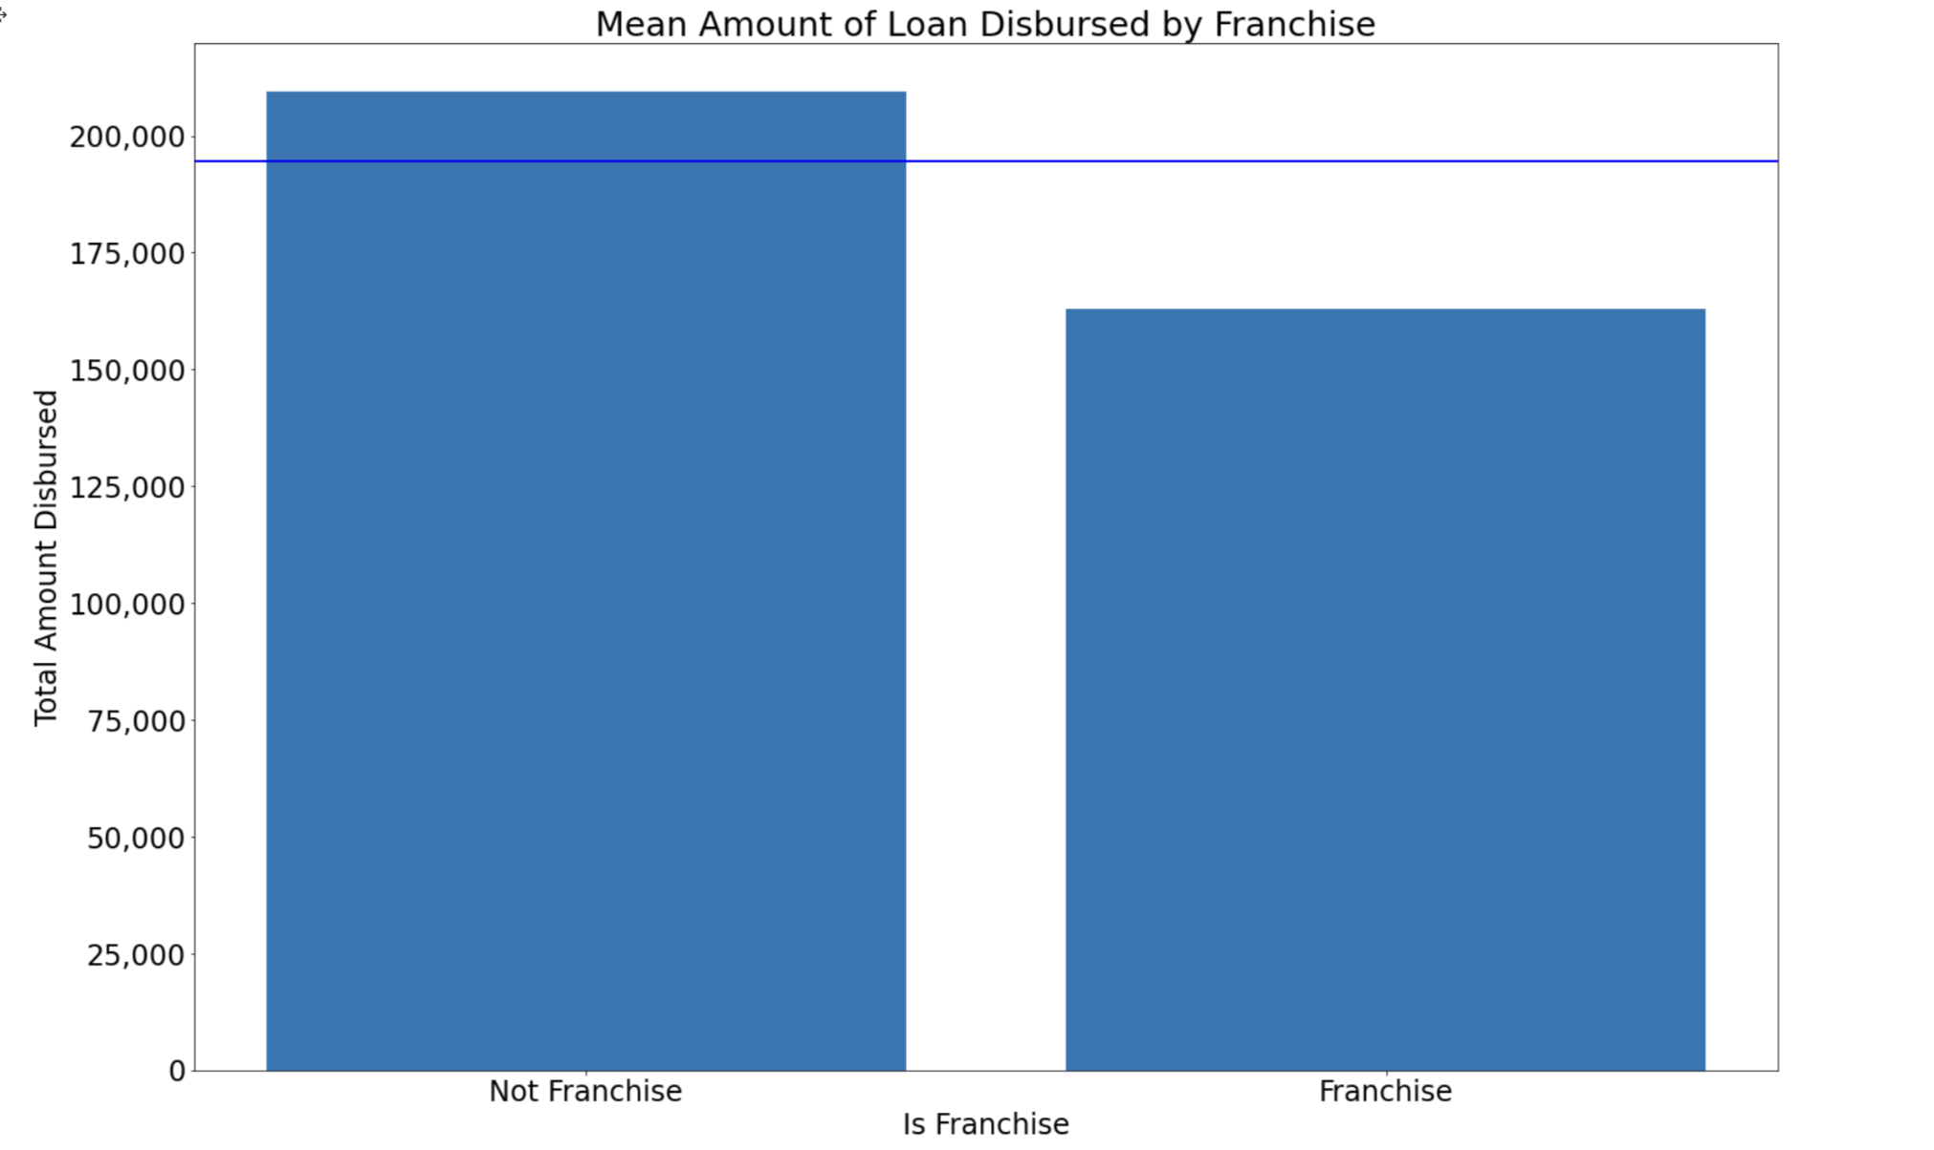
Average Loan Disbursed by Franchise
Businesses that are not a franchise make more than the average loan disbursed.

Slide 8
What factors tend to cause a loan to be defaulted on?

Slide 9
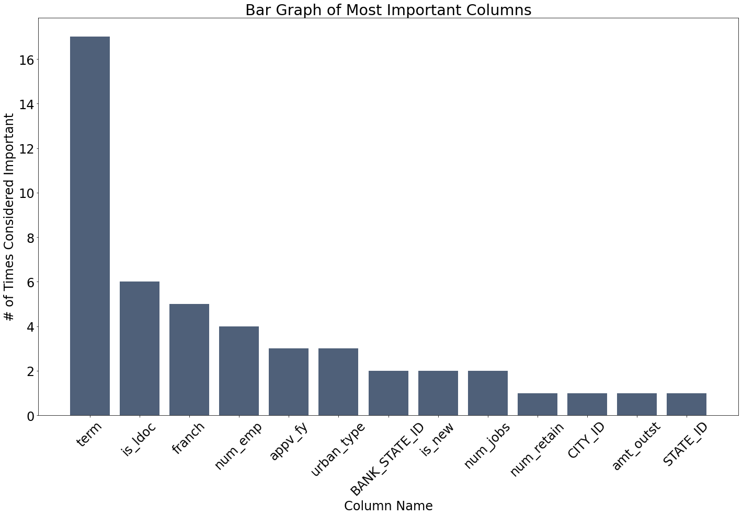
Determining Important Factors
Term appeared in every trial telling us it is the most important factor in producing a high accuracy model.
Notes:
Each trial gives the combination of columns that produce the highest prediction accuracy in predicting defaulted loans.

Slide 10
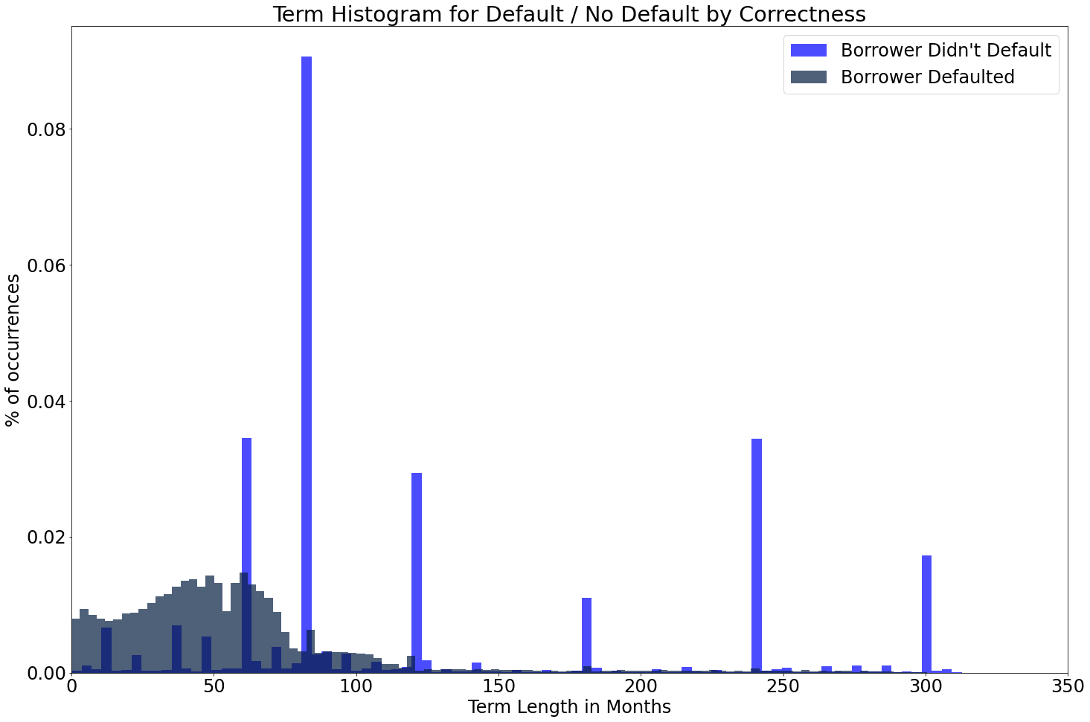
Deeper Dive: Term
Borrowers who didn’t default have the highest frequency
People who don’t default usually have loan terms of 60, 80, 120, 180, 240 and 300 months.
Notes:
normalize=true
Longest term - 700 months ~ probably still paying back
Spikes - people who usually dont default have a plan??? Idk how to say that
People who dont default have common set terms
Histogram separated by whether borrower defaulted or not.
Maybe this is because there is some sort of program that recommends getting loan terms at these values.

Slide 11
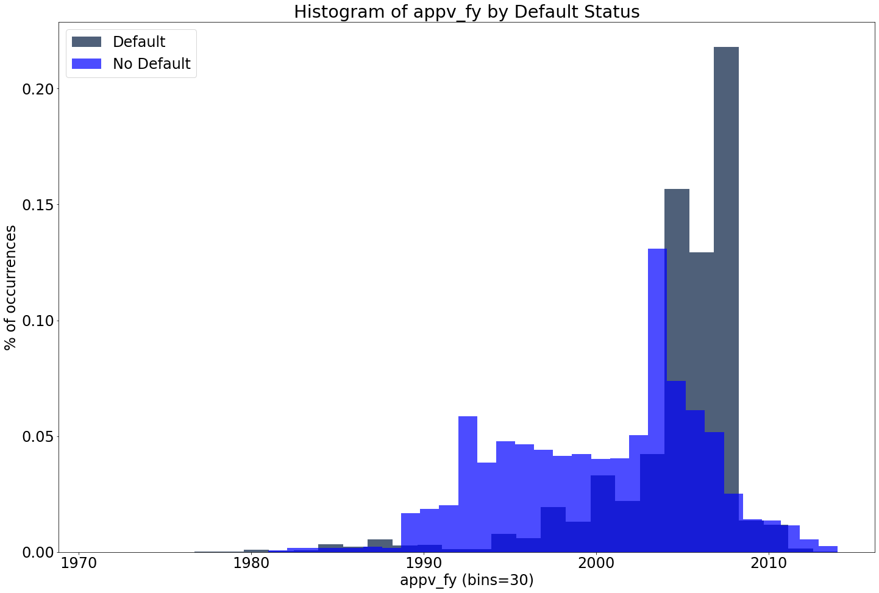
What if we only looked at the year of approval?
Fiscal year of approval seemed to be the second best “predictor”
2008 recession
Notes:
Approval year was the second most important even though
Best time to get a loan is from 1990-2000
Recession cause defaulting on loans
but the year being 2008 wasn't the cause of the recession, it was some other variable not accessible.

Slide 12
Model to predict which approved loan applications will default

Slide 13
Prediction Model Summary
Used scikit-learn logistic regression to predict if a borrower defaulted or not.
Only 18.16% of all borrowers defaulted, therefore data was balanced by sampling from non-defaulters.
Using 2 out of 27 columns: loan term, and fiscal year of approval.

Slide 14
Prediction Model
Precision: Out of the loans we predicted to have defaulted, 77% of them were actually defaulted.
Recall: From all the defaulted loans, 83% of them were predicted correctly.
Similarly, for the "False" defaulted, see that out of the loans that actually did not default, our model predicted 75% of them correctly.
Accuracy: Out of the loans that actually did default, we predicted 79% of them would default.
default precision recall f1-score support
False 0.81 0.75 0.78 47832
True 0.77 0.83 0.80 48302
accuracy 0.79 96134
macro avg 0.79 0.79 0.79 96134
weighted avg 0.79 0.79 0.79 96134
Notes:
Precision: from all the classes we have predicted as positive, how many are actually positive.
Recall: from all the positive classes, how many we predicted correctly
Accuracy: From all the classes (positive and negative), how many of them we have predicted correctly

Slide 15
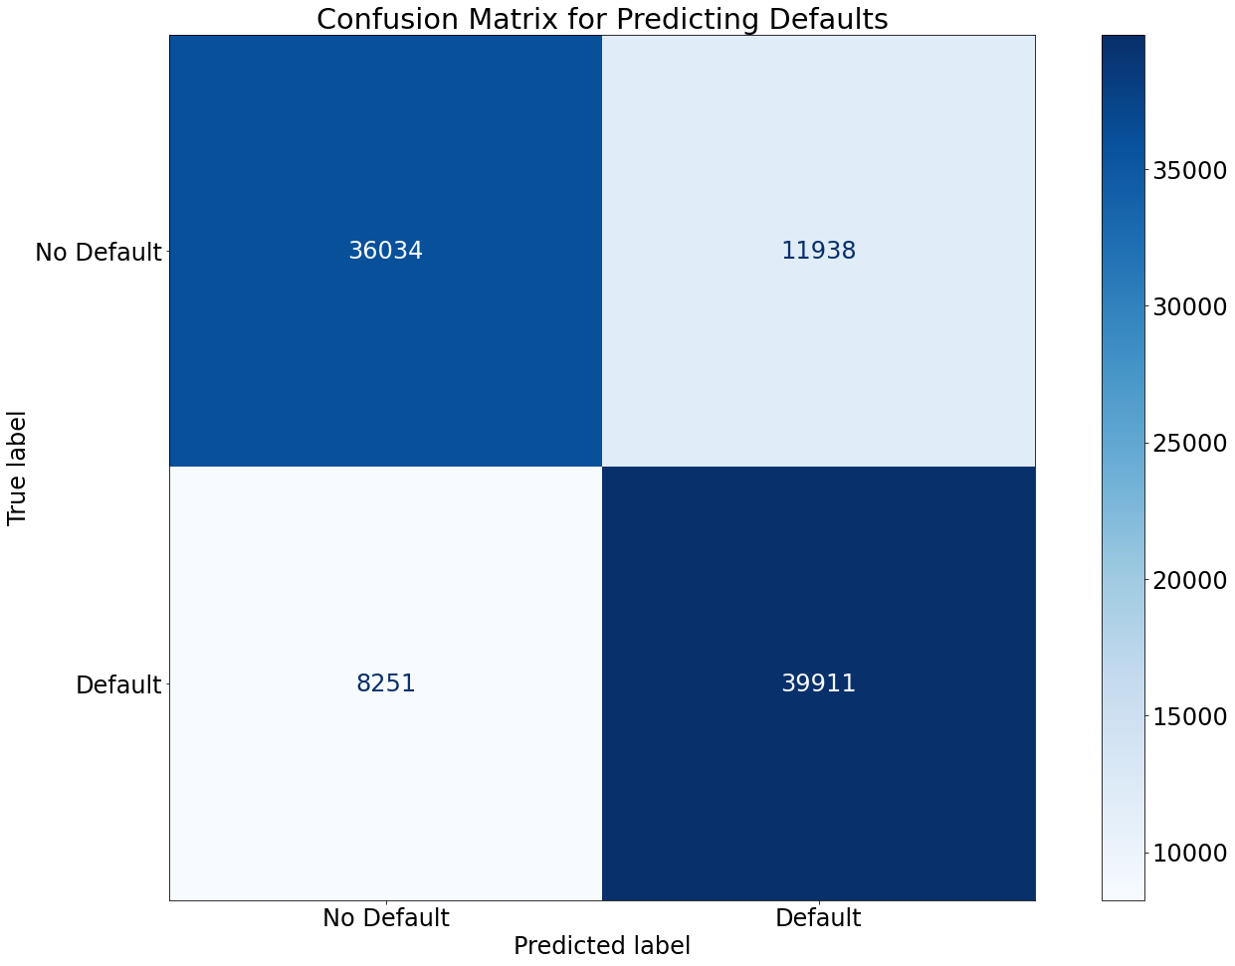
Confusion Matrix
75.11%
24.89%
This model is better at predicting defaults than non-defaults
17.13%
82.87%
Notes:
Model does have trouble classifying non-defaults, this is because only using 2 columns

Slide 16
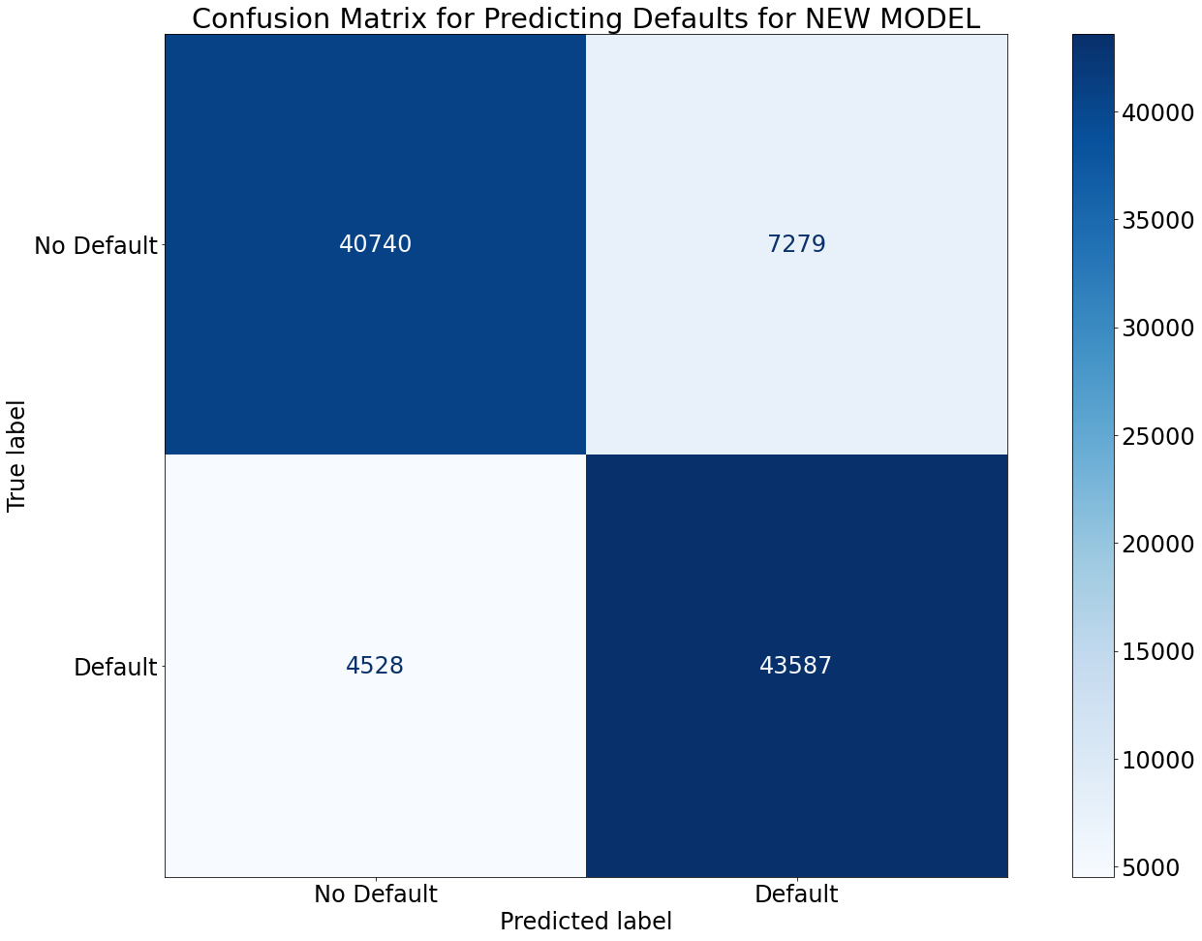
There is a better model.
84.84%
15.16%
9.41%
90.59%
Previous model: 79% accuracy avg.
New model: 88% accuracy avg.
[84, 60, 240, 120, 300, 180, 36, 12, 48, 72, 24, 96, 90]

Slide 17
Findings
Term and fiscal year of approval are the two factors that gave a high model accuracy.
We can predict if a loan will default with 88% accuracy using a logistic regression model.
Non-Franchise Businesses make higher than the average loan disbursement.
New Businesses get higher loans.
Management and Utilities Industries on average get higher loans.

